Slide 1
Guest Management System Project Report
Anguyo Francis
Course: Database Systems
Date: 2026

Slide 2
Agenda
This presentation explains the Guest Management System from the problem it solves to the final implementation.
It covers the
executive summary
business case
design, implementation, and the queries used in the system.
The last section includes the conclusion and references used during development.
Guest Management System Project Report

Slide 3
Executive Summary
The project develops a centralized guest management system for a hospitality environment.
It stores:
guest details, loyalty program information, feedback, and preferences in one place.
The system was built using MySQL for the database and PHP for the web interface.
Its purpose is to improve organization, speed up service, and support a better guest experience.
Guest Management System Project Report

Slide 4
Business Case: Problem Statement
Guest information is often kept in separate files or manually written records, which causes duplication and mistakes.
Without proper tracking, staff cannot easily remember guest preferences or provide personalized service.
Loyalty rewards are difficult to manage when guest records are not linked to a structured database.
Guest feedback may be collected informally and therefore not used to improve service quality.
Manual handling of records takes time and reduces staff efficiency.
Guest Management System Project Report

Slide 5
Business Case: Proposed Solution
The system stores all guest information in one structured database, making records easy to access and update.
Guest preferences and feedback are saved so that future visits can be more personalized.
Loyalty tiers can be assigned and managed automatically based on stored points or status.
The solution reduces manual work and helps staff focus more on service delivery.
It also creates a foundation for reports and future data analysis.
Guest Management System Project Report

Slide 6
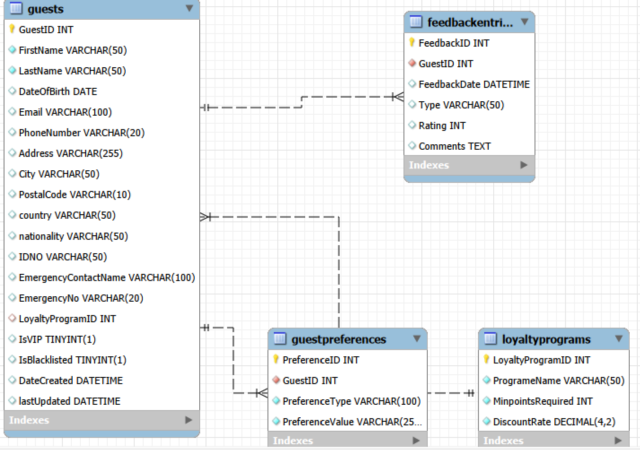
Design: Logical Database Structure
The logical design describes the main data entities and how they relate to each other.
Guests is the central table because it stores the core record for every guest.
Loyalty Programs stores loyalty tiers such as Silver, Gold, or Platinum.
Feedback Entries stores what guests say about their experience after a stay.
Guest Preferences stores things the guest likes, such as room type or meal preference.
The relationships are mostly one-to-many, meaning one guest can have many feedback or preference records.
Guest Management System Project Report

Slide 7
Design: Physical Database Implementation
The logical entities were converted into actual MySQL tables.
Each table uses a primary key to identify its records uniquely.
Foreign keys connect related tables and protect data consistency.
The database uses data types such as VARCHAR, INT, DATE, DATETIME, BOOLEAN, and TEXT.
Constraints like UNIQUE, DEFAULT, and AUTO_INCREMENT improve the quality of stored data.
Guest Management System Project Report

Slide 8
Implementation: System Architecture
The frontend is built with HTML and CSS to display the guest dashboard in a clear and friendly layout.
PHP acts as the backend and handles requests such as viewing guests, filtering, and searching.
MySQL stores all records and returns the required results when the PHP code queries it.
The browser, PHP server, and database work together to create a complete web-based system.
Guest Management System Project Report

Slide 9
Implementation: Guest Management Dashboard
The dashboard gives the user one main screen for managing guest records.
A search bar helps staff quickly find a guest by name or email.
Filter options make it easier to separate VIP guests, blacklisted guests, or guests with preferences.
Action buttons allow the user to view, edit, or delete guest records.
This design improves speed and makes the system easy to use.
Dashboard Screenshot Here
Guest Management System Project Report

Slide 10
Implementation: Guests Table Structure
GuestID is the primary key and automatically increases for each new guest.
FirstName, LastName, Email, and Phone Number store identity and contact details.
Address, City, Country, Postal Code, and Nationality store location-related information.
IDType and Number are used for identification records.
IsVIP and IsBlacklisted indicate special status, while LoyaltyProgramID links the guest to a loyalty tier.
Guest Management System Project Report

Slide 11
Implementation: LoyaltyPrograms Table
LoyaltyProgramID uniquely identifies each loyalty tier.
ProgramName stores the name of the tier, such as Bronze, Silver, or Gold.
MinPointsRequired shows the minimum points needed to qualify for the tier.
DiscountRate stores the benefit given to guests in that program.
Guest Management System Project Report

Slide 12
Implementation: Feedback and Preferences Tables
FeedbackEntries stores guest opinions, ratings, and comments after staying at the facility.
GuestPreferences stores personal choices that help the business offer tailored service.
These tables are linked to Guests through GuestID, so each record belongs to a specific guest.
Together, they help the business understand the guest better and improve future service.
Guest Management System Project Report

Slide 13
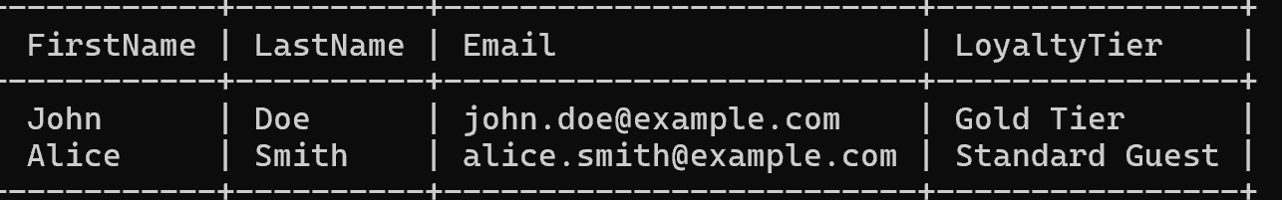
Implementation: Essential Query 1
This query retrieves guest names together with their loyalty tier.
It is useful for the dashboard because it combines information from different tables in one result.
The LEFT JOIN ensures that guests still appear even if they do not have a loyalty program assigned.
This is an important part of displaying complete guest information.
SELECT g.FirstName, g.LastName, lp.ProgramName FROM Guests g LEFT JOIN LoyaltyPrograms lp ON g.LoyaltyProgramID = lp.LoyaltyProgramID;
Guest Management System Project Report

Slide 14
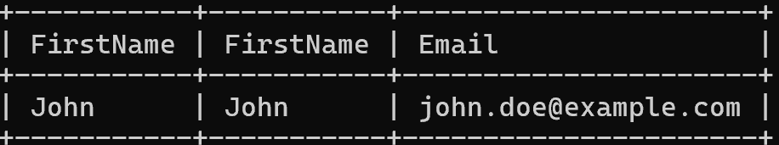
Implementation: Essential Query 2
This query filters the database to show only VIP guests.
It is used when the user selects the VIP filter on the dashboard.
Filtering helps staff focus on high-priority guests quickly.
Similar conditions can also be used for blacklisted guests or search results.
SELECT * FROM Guests WHERE IsVIP = 1;
Guest Management System Project Report

Slide 15
Conclusion
The Guest Management System provides a practical way to organize and use guest information.
It improves service quality by supporting personalization, loyalty tracking, and feedback management.
It also reduces manual work and makes data easier to access.
The system can be expanded later with bookings, payments, reports, or email notifications.
Guest Management System Project Report

Slide 16
Bibliography / References
MySQL Documentation.
PHP Manual
Database book provided
Guest Management System Project Report

